Slide 1
Network devices
The lecture 8

Slide 2
Hubs and Switches

Slide 3
Hubs and Switches

Slide 4
Hubs – Half-Duplex and Shared Collision Domain

Slide 5
Switches – Full-Duplex and Separate Collision Domains

Slide 6
Cisco Device Functions

Slide 7
Hubs operate at OSI Layer 1

Slide 8
Switches operate at OSI Layer 2

Slide 9
Switches operate at OSI Layer 2

Slide 10
Switch Operation

Slide 11
Switch Operation

Slide 12
Switch Operation

Slide 13
Switch Operation

Slide 14
Switch Operation

Slide 15
Switch Operation

Slide 16
Switch Operation

Slide 17
Switch Operation

Slide 18
Switch Operation

Slide 19
Switch Operation

Slide 20
Switch Operation

Slide 21
Switch Operation

Slide 22
Switch Operation

Slide 23
Switch Operation

Slide 24
Switch Operation

Slide 25
Switch Operation

Slide 26
Switch Operation

Slide 27
Switch Operation

Slide 28
Switch Operation

Slide 29
Switch Operation

Slide 30
Switch Operation

Slide 31
Switch Operation

Slide 32
Switch Operation

Slide 33
Switch Operation

Slide 34
Switch Operation

Slide 35
Routers

Slide 36
Routers vs Switches

Slide 37
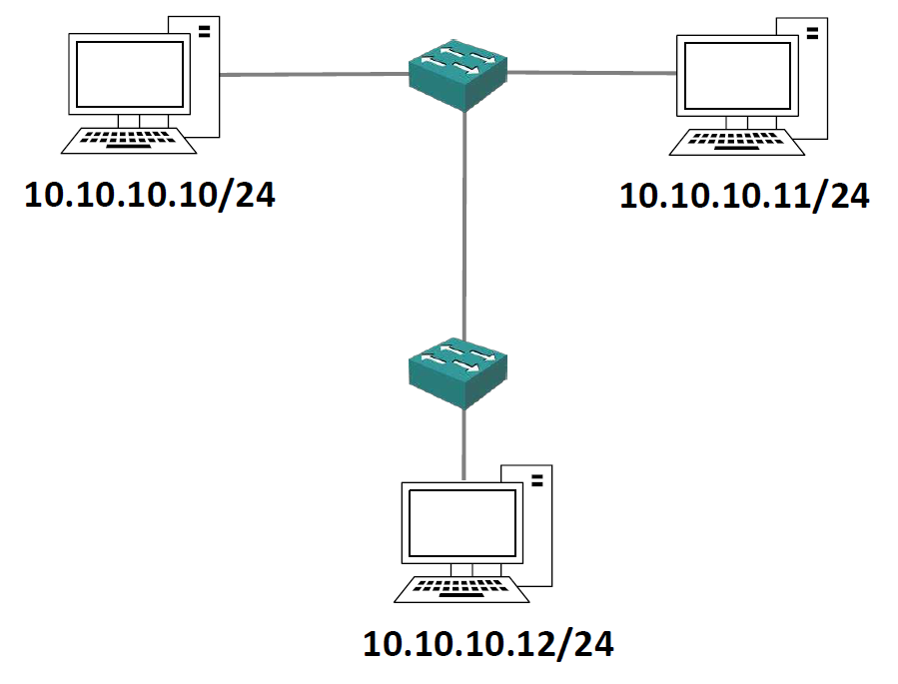
Switch Operation

Slide 38
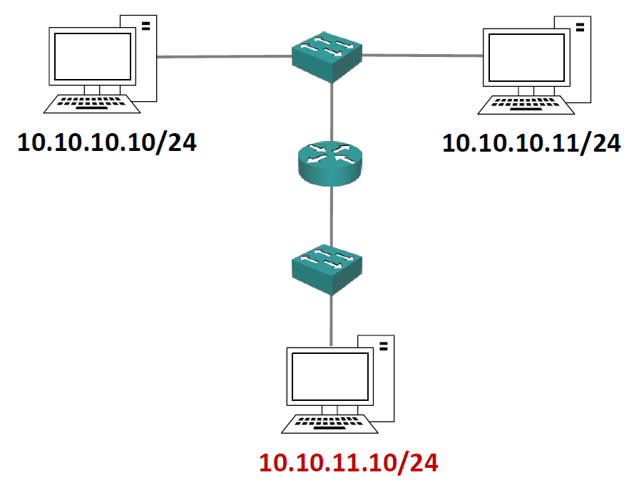
Router Operation

Slide 39
Layer 3 Switches

Slide 40
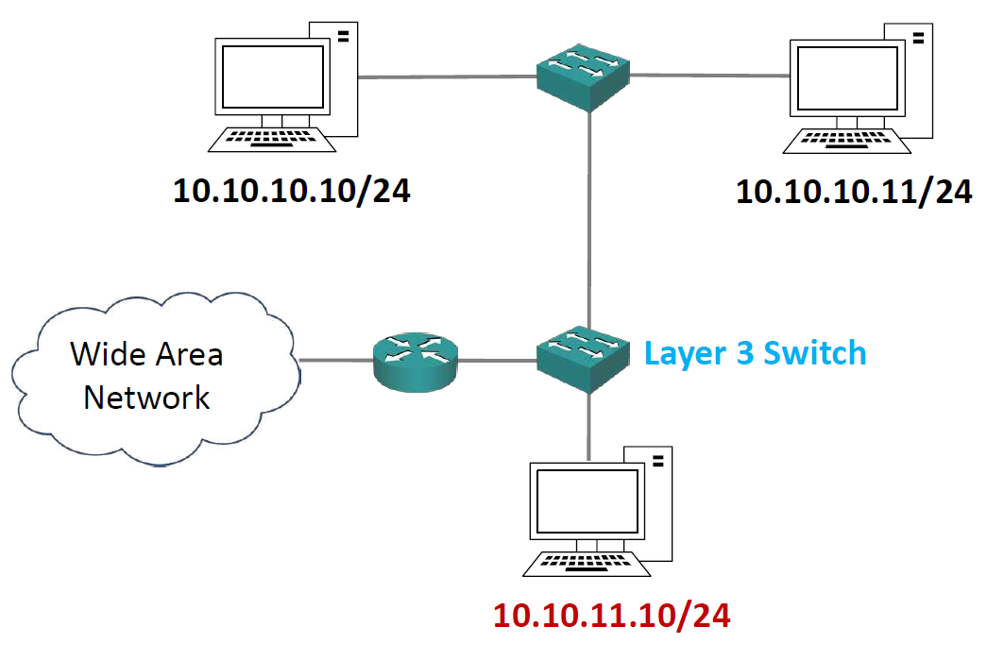
Layer 3 Switch Operation

